Slide 1
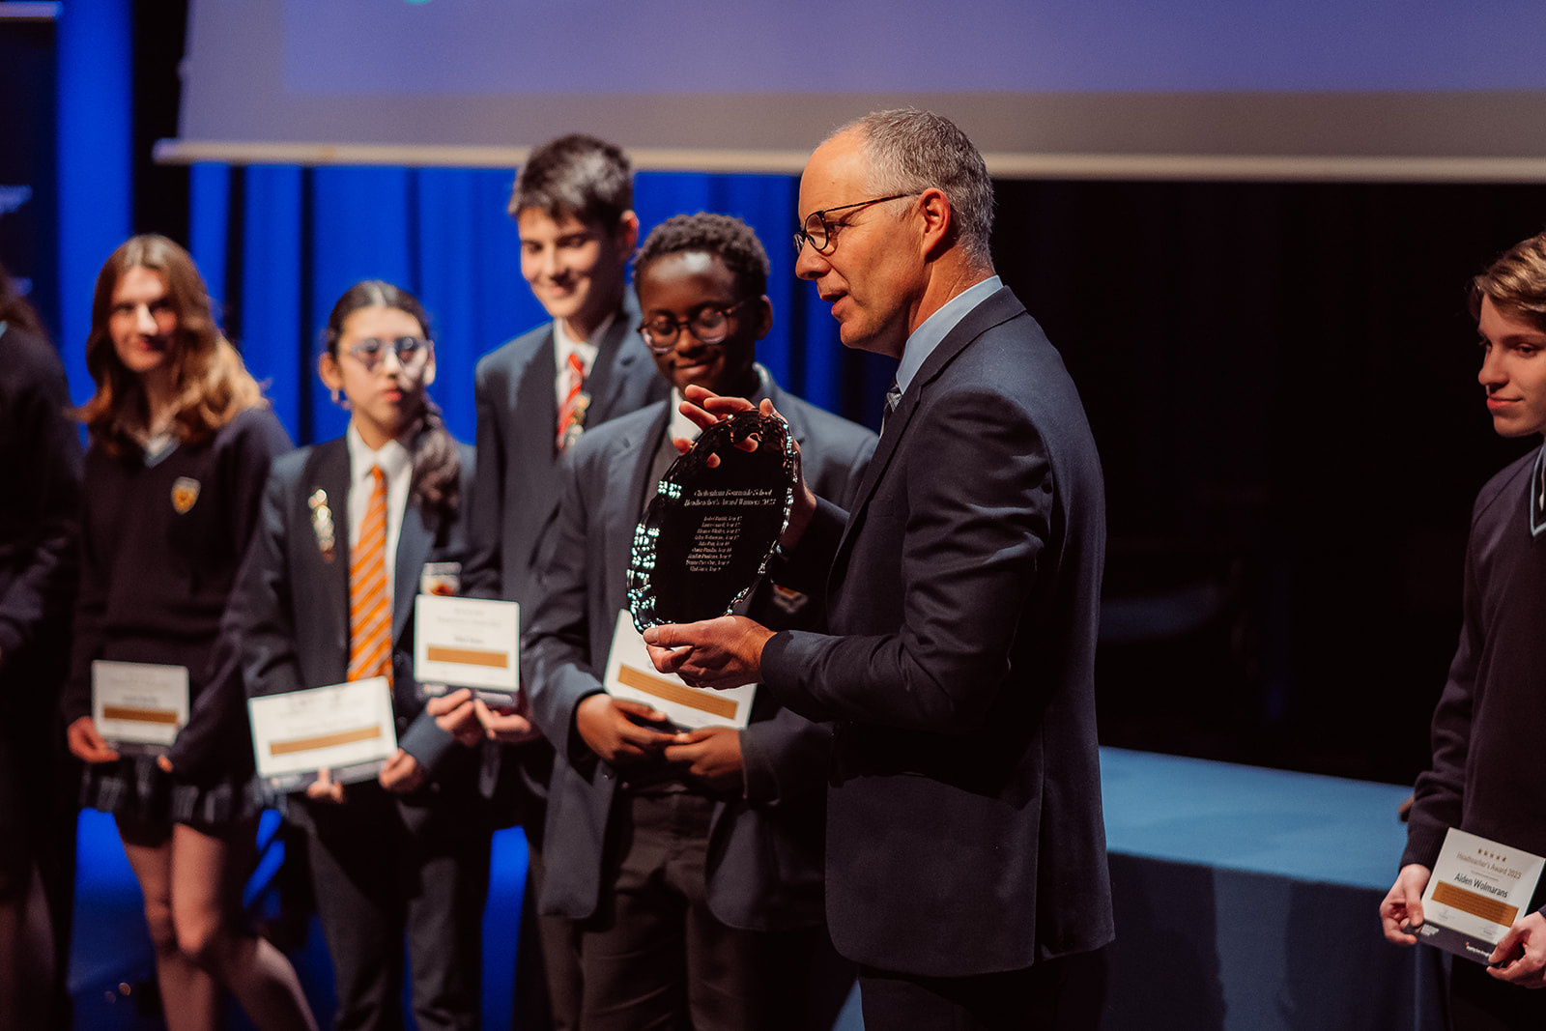


8th January 2025
Steve Jefferies, Headteacher
Your child’s future at our school
SDG PROGRESS REPORT 2025
Inspiring lives through learning

Slide 2
8th January 2025
Karen Hanley, Deputy Headteacher
Choosing GCSE Options
SDG PROGRESS REPORT 2025
Inspiring lives through learning

Slide 3
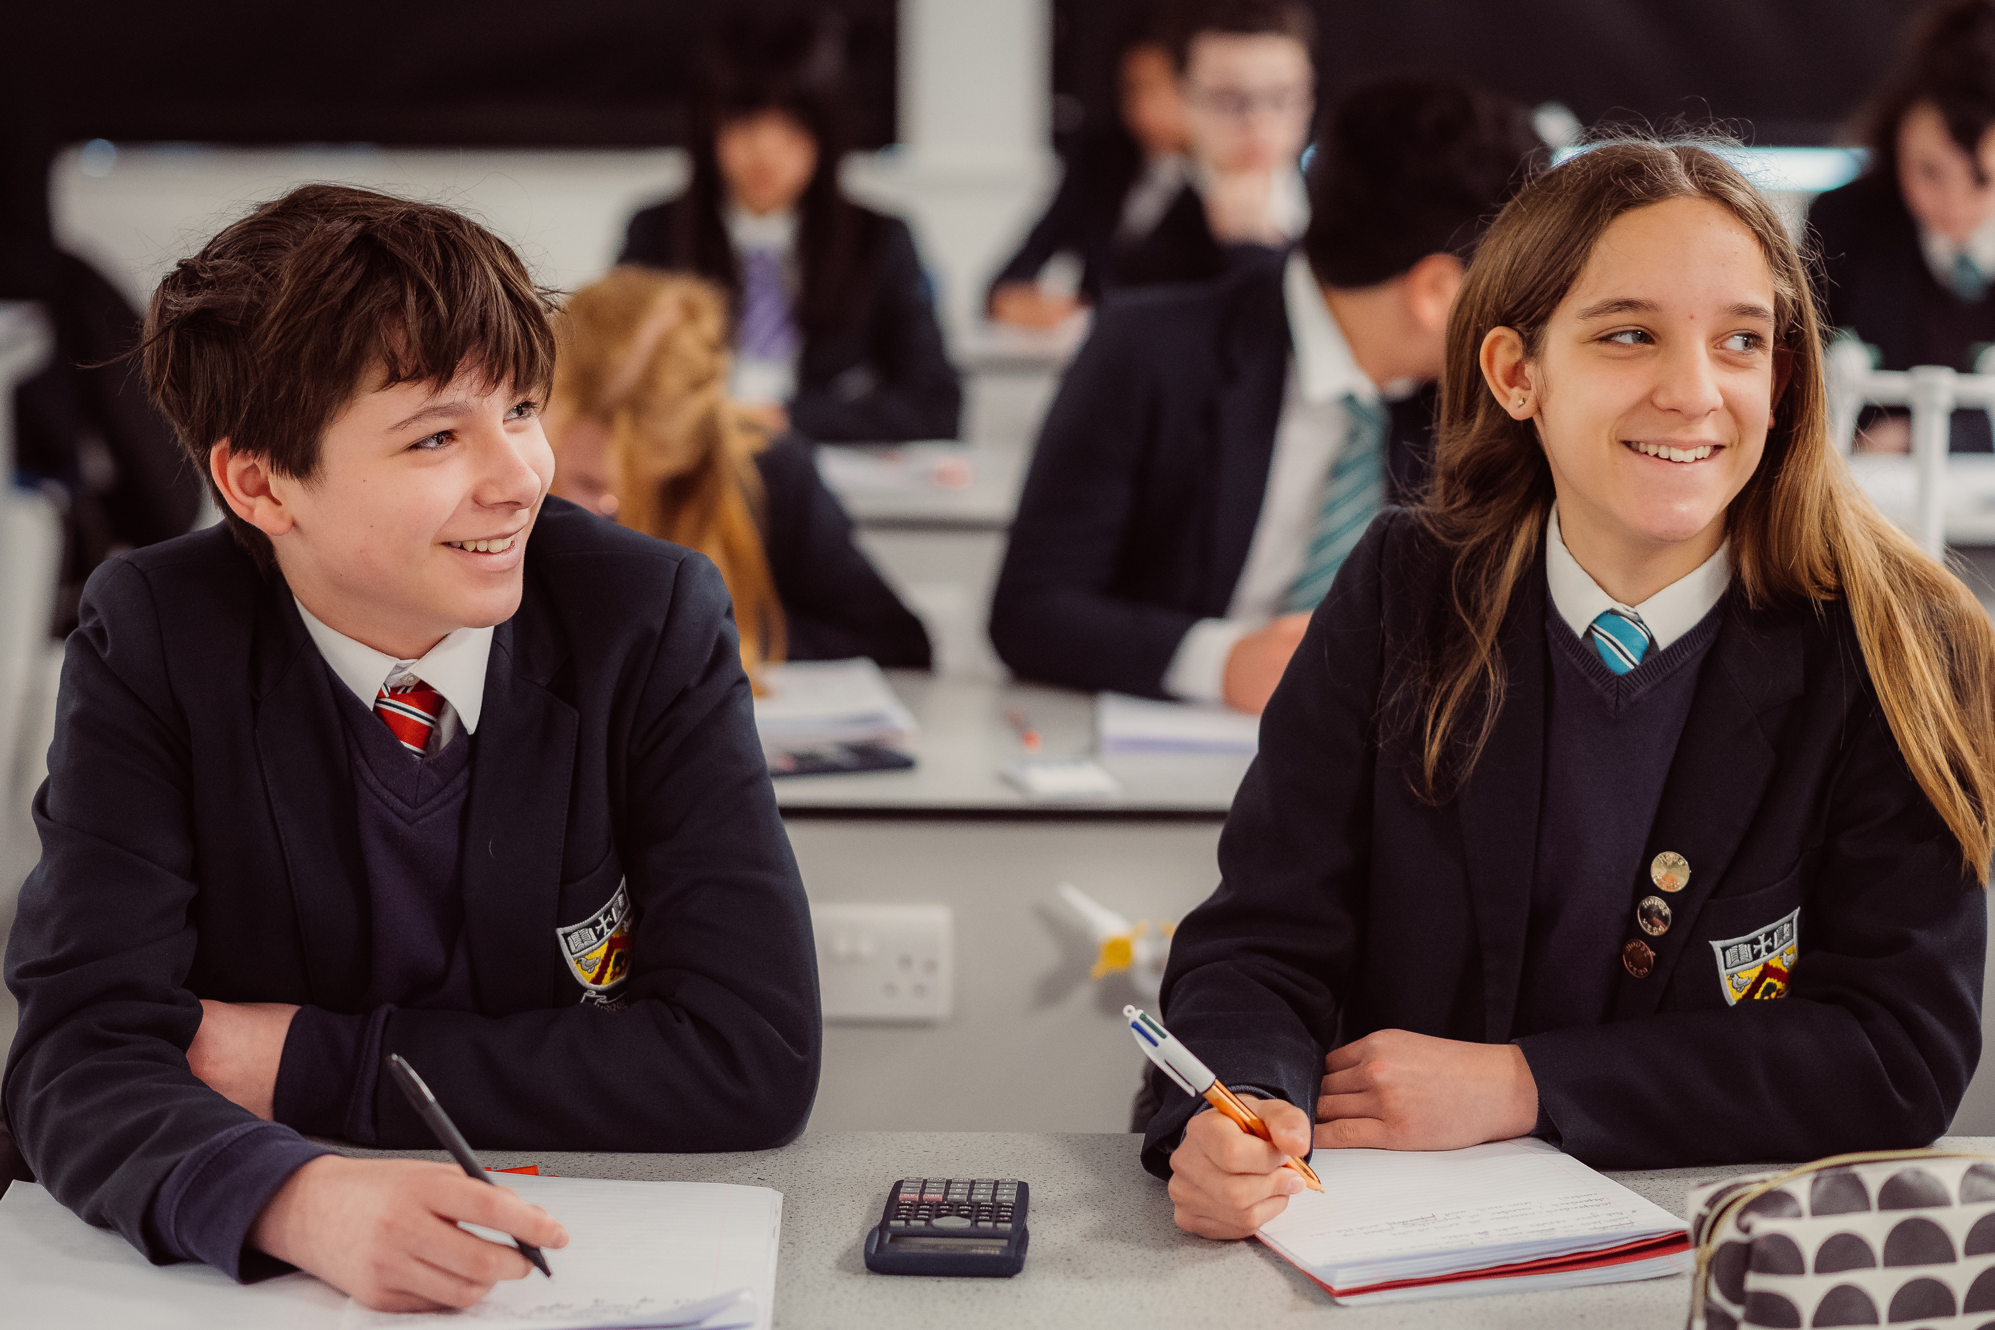
Making the right subject choices – what we will be doing to support your son/daughter(s)
They should already be asking themselves, as I am sure you are encouraging them to do:
What do I enjoy studying?
What subjects am I good/best at?
What do my parents/carers think?
What advice have my teachers given me?
How does my choice affect my future?
The last question is the most important and should be the most important question – they have, for the first time, choices – they need to use them wisely – what they chose now can influence their future pathway(s)
SDG PROGRESS REPORT 2025
Inspiring lives through learning

Slide 4
Why is choice so important at the end of Year 9?
There are two main reasons:
Some subjects are pre-requisites for certain careers
Some subjects can only be taken through to A Level if they have studied the subject at GCSE e.g. Languages
Also, some universities, apprenticeship providers and employers want specific subjects for degree or other courses/training placements and so making the right choice now is so important
Universities highly value the English Baccalaureate as a measure of academic potential and success (EBacc = English, Maths, Science, a Language and a Humanity subject (History or Geography))
But don’t worry about this – we are here to support them and you through this decision-making process. The first place to look is our Options site – they can access this on our school website – under the Parents Tab; look for Options.
Inspiring lives through learning

Slide 5
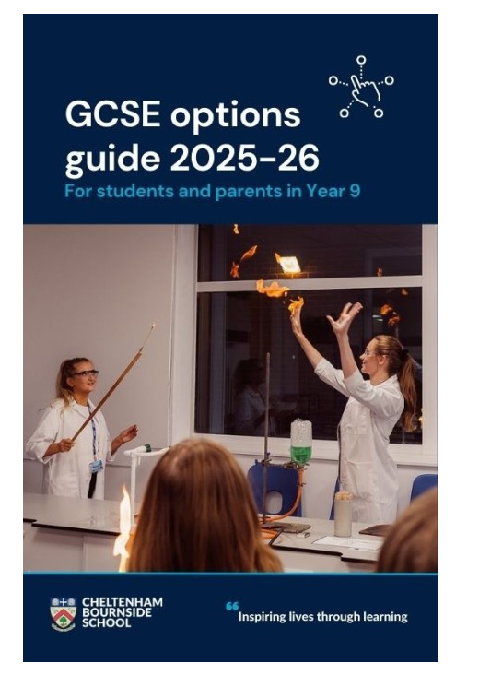
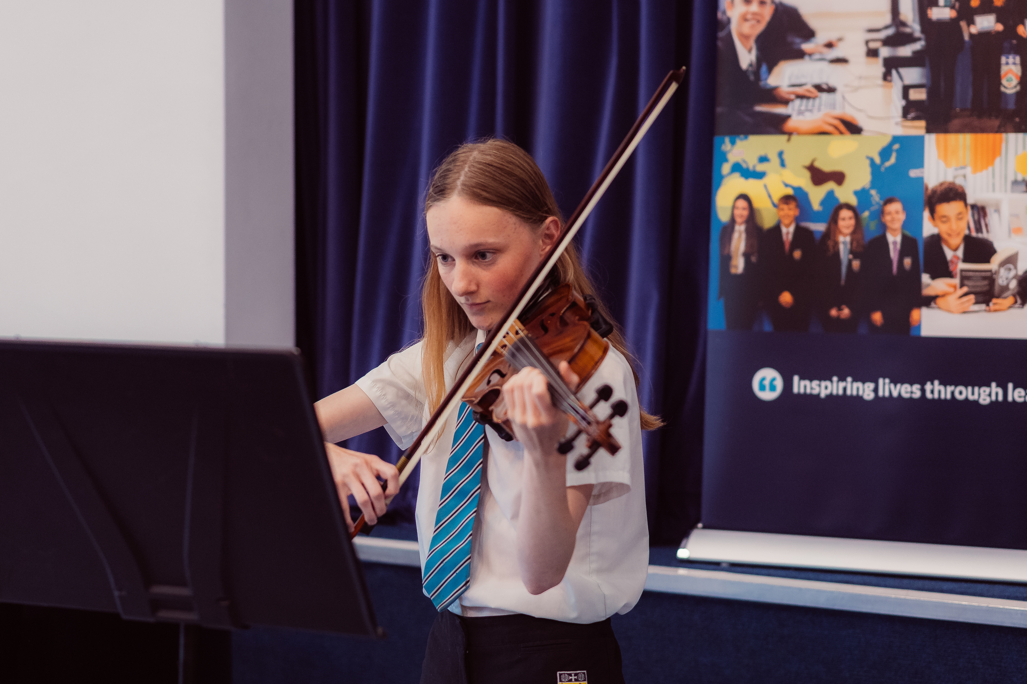
This booklet is in an Options area on our school website
You will find it under the Parents tab – called Options
The key dates are listed and then you can open this booklet and read about all the different options you can take in Years 10/11
Inspiring lives through learning

Slide 6
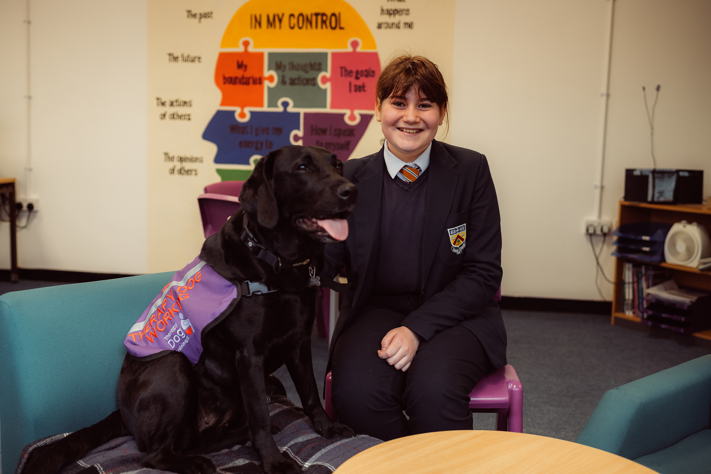
Spend some time looking at this area on the website
On the front page – you will find a calendar of key events
Please then look at each section in the booklet:
Compulsory subjects – information on the core that all students study
Optional subjects – information on each of our 28 GCSE/Level 2 courses that they can chose from
Careers information and help/guidance is found on the School Life page of our website – Careers & Work-related learning section
Options Form – this will not be live until February 7th and so you will not be able to access this form yet. Mrs Duggan will send an email to you nearer the time when this form goes live about completing the form.
Deadline for choices – Monday 24th February, 9am
SDG PROGRESS REPORT 2025
Inspiring lives through learning

Slide 7
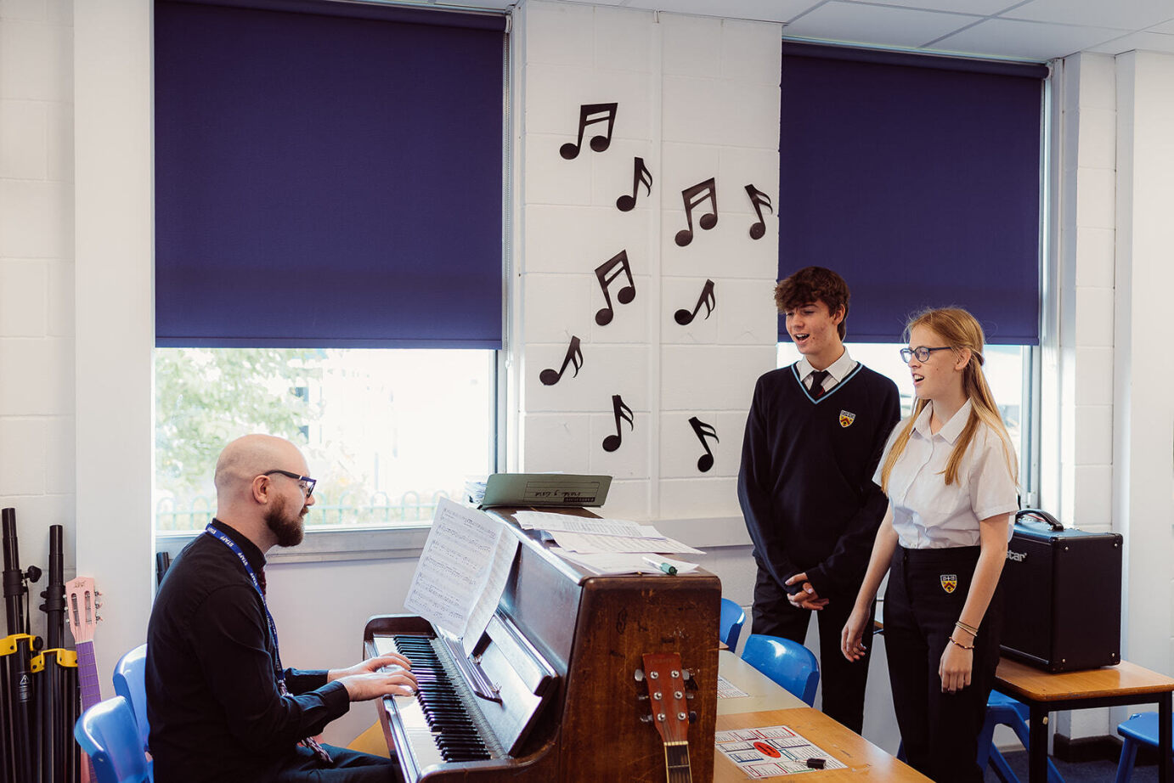
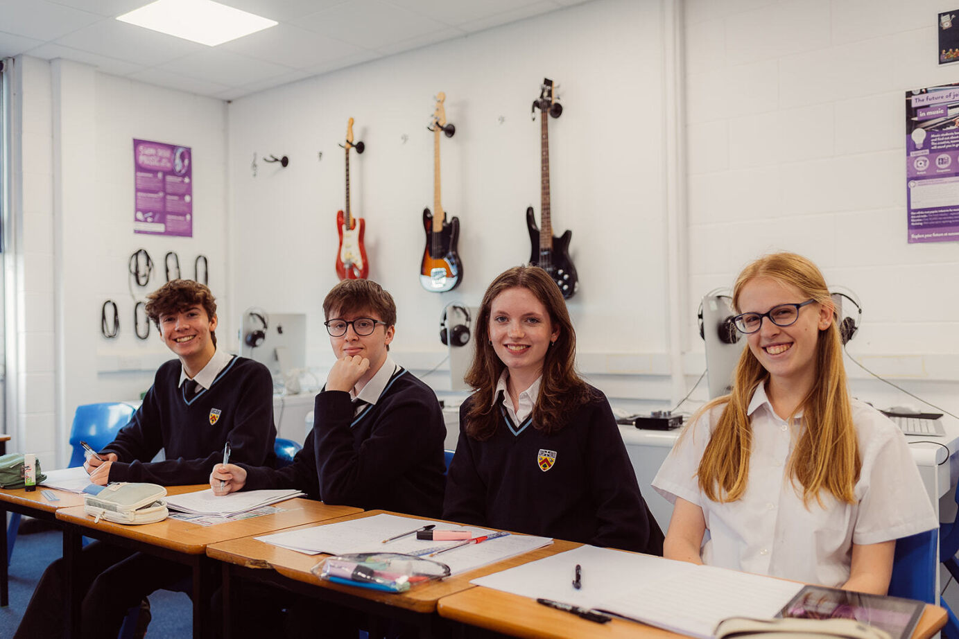
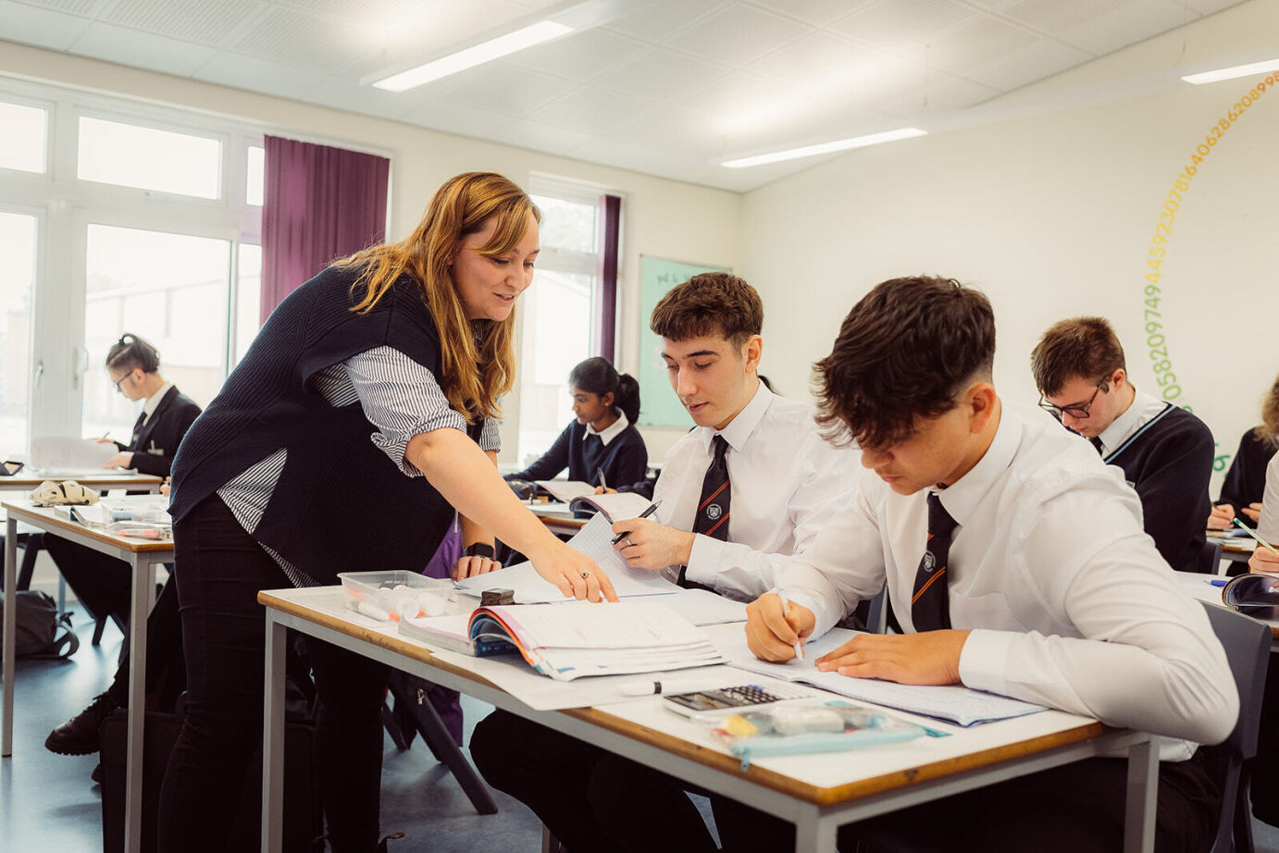
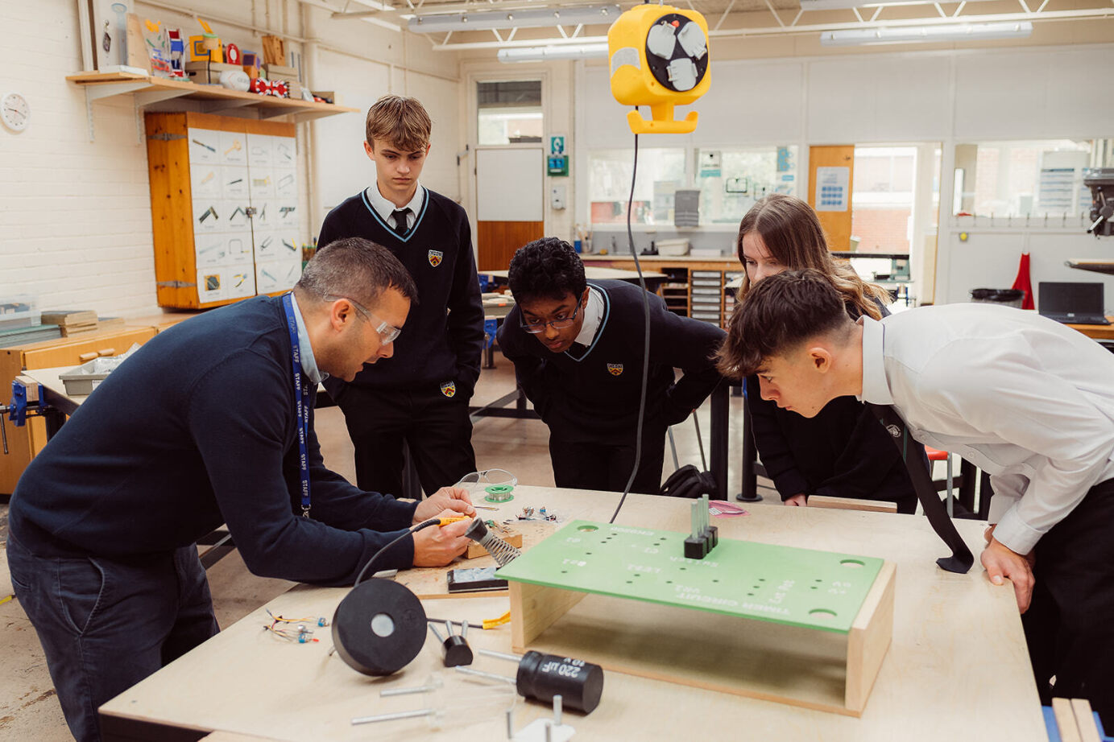

Where next – Sixth Form, College or Apprenticeship
Entering employment, higher education or apprenticeships is just around the corner for them – and that path begins in post-16 education – whether Bournside sixth form, employment, at college or on an apprenticeship.
Inspiring lives through learning

Slide 8
What subjects must they study?
The Core (30 hours per cycle):
English Language and Literature GCSEs (9 hours)
Maths GCSE (8 hours)
Science GCSEs (2/3 GCSEs) (9 or 14 hours)
Sport and Games (not examined) (2 hours)
Education for Life and Religion & Worldviews (not examined) (2 hours)
PLUS:
4 additional subjects – at LEAST ONE must be (Triple) Science, History, Geography, Computer Science or a Modern Foreign Language (French, German, Spanish or Mandarin) – 5 hours each per cycle (20 hours in total per cycle)
SDG PROGRESS REPORT 2025
Inspiring lives through learning

Slide 9
The subjects in black text are GCSEs
The ones in purple are Level 2 courses = equivalent to GCSEs
Foundation Learning is not a GCSE
Home languages
** Studied after school
What are the optional subjects that they can study?
Art & Design - 3D Design
Art & Design - Fine Art
Art & Design – Photography
Astronomy **
Business Studies
Vocational Business: Retail Business (WJEC Level 2)
Computer Science
Creative ICT – iMedia (Cambridge National Award Level 2)
Dance
Drama
Food Preparation & Nutrition
D&T (Product Design)
D&T (Textiles)
French
Health & Social Care (BTEC Level 2)
Geography
German
History
Latin **
Mandarin
Media Studies
Music
PE
Religious Studies
Sociology
Sport (BTEC Level 2)
Spanish
Foundation Learning
Additional Languages
SDG PROGRESS REPORT 2025
Inspiring lives through learning

Slide 10
How can you help them make these decisions?
Four main ways:
Look at the Options site and make a short list of options that they want to consider
Look at the Careers information and consider which options they need to consider
Encourage them to seek advice from their teachers, school staff etc. You will have an opportunity to do this at the Year 9 PTC in early February; staff will also provide them information in lessons over the next few weeks about the options in their subject(s)
Read our Sixth Form prospectus – this will go live later this month with an introduction from Mr Warren, our Head of Sixth Form.
Ask them once they have chosen their GCSE options: Are they sensible choices given their current career thoughts/pathways sought? If these are not clear to them yet, encourage them to keep their options broad to keep their options open….
SDG PROGRESS REPORT 2025
Inspiring lives through learning

Slide 11
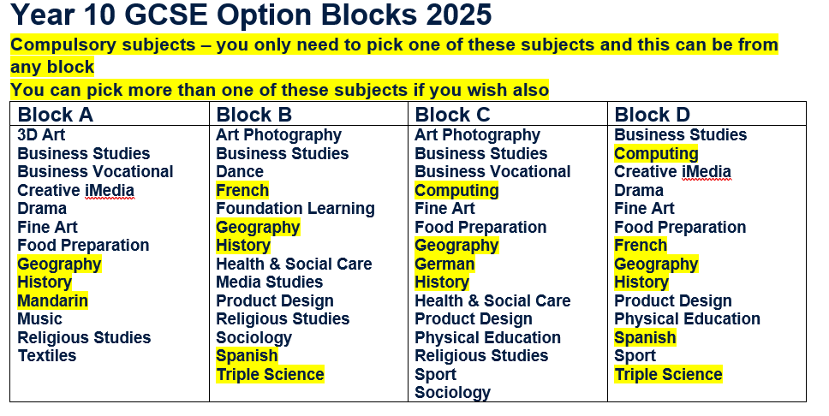
How will they choose their options?
Using a form – more details to follow – one subject choice per block, plus one reserve choice per block
Must include your compulsory choice
SDG PROGRESS REPORT 2025
Inspiring lives through learning

Slide 12

Which route through Science?
GCSE Combined Science – this is the route that most students will follow, where they will gain 2 GCSE grades/qualifications i.e. a Double Science qualification.
GCSE Separate Sciences – they will study three separate sciences leading to GCSEs in Biology, Chemistry and Physics. Separate grades will be achieved for each science. To do this they must chose (Triple) Science as their/one of their compulsory option choice(s).
Both routes are suitable preparation for any A Level Science course(s).
SDG PROGRESS REPORT 2025
Inspiring lives through learning

Slide 13
What is a “Pathway”?
It might be that they put a package of options together that might lead to a certain career – I have put some examples below:
Art and Design Pathway – Fine Art, Media Studies and Creative iMedia
Humanities Pathway – Geography, History and Religious Studies
Technology Pathway – Computing, Product Design and Creative iMedia
Healthcare Pathway – Health & Social Care and Sociology
Languages Pathway – at least two Language options
There are others.
Universities prize the English Baccalaureate – to get this you would need to study History or Geography and a Modern Foreign Language, alongside English, Maths and Science. When these subjects are added to the Core, this gives you a broad, academic set of options that top universities are often looking for when looking at applications.
SDG PROGRESS REPORT 2025
Inspiring lives through learning

Slide 14
What is “Foundation Learning”?
This is a package of support for those students who we identify will:
Find the full range of GCSEs quite demanding
Need additional support with literacy and numeracy
Need additional support accessing Post-16 options
Benefit from focusing on a (work) skills approach to support future progression
This is a very bespoke offer and is adaptable across the 2 years of Year 10&11. Mrs Groves and Mr Mudge will work with myself identifying and talking to those students who we believe this course might be suitable for and we will be in contact with them.
SDG PROGRESS REPORT 2025
Inspiring lives through learning

Slide 15
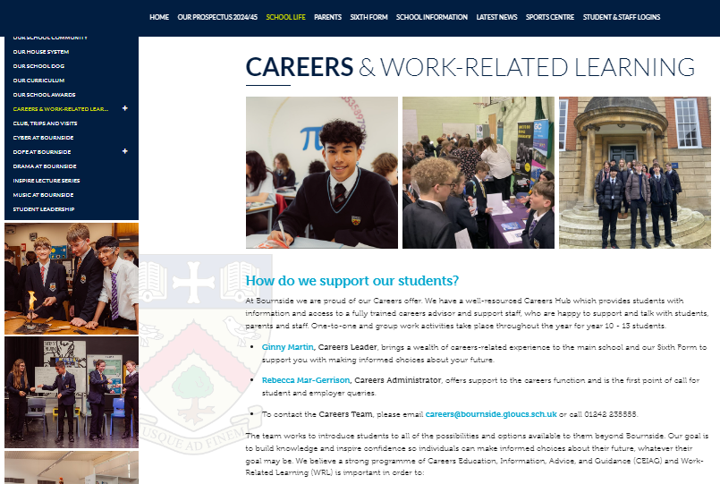
Help and Support with Careers
They will be looking at their option choices within Education for Life lessons during January/February – this will help them with answering some of their questions. You/they can also use the links on the school website and the various websites we subscribe to e.g. Unifrog.
SDG PROGRESS REPORT 2025
Inspiring lives through learning

Slide 16
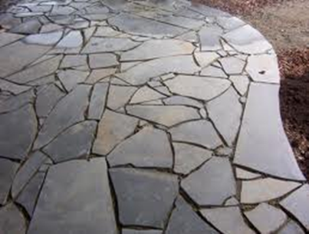
Help and Support with Careers – 21st Century Careers
Their Career – not a linear path but crazy paving which they have to lay themselves
Adapted from:
Dominic Cadbury, past CEO and Chief Executive of Cadbury Schweppes Plc
SDG PROGRESS REPORT 2025
Inspiring lives through learning

Slide 17
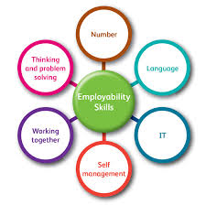

Help and Support with Careers – 21st Century Careers
Qualifications are very important, but they are more flexible (and they may need to be more flexible) than you might think ….
Employers want qualifications but they also look for “employability” – key skills, attitudes, personal qualities and knowledge (not just knowledge)
SDG PROGRESS REPORT 2025
Inspiring lives through learning

Slide 18
Mrs Martin and myself will be available at the Year 9 PTC and we are contactable by email – gcm@ or kjh@
We use Unifrog with all of our students
As a parent/carer you can login and use Unifrog just like your son/daughter – sign in to Unifrog with a code – https://www.unifrog.org/code
The code you will need to use is: BOEFfamily2024
You will only need to use it the first time you login, after that point you just login with whichever password you have created.
The following video might also help show you how Unifrog will help you and your son/daughter over the next few years.
https://www.loom.com/share/1d856c8220f444faa653fd7f719db5c8
SDG PROGRESS REPORT 2025
Inspiring lives through learning

Slide 19

SDG PROGRESS REPORT 2025
Inspiring lives through learning

Slide 20
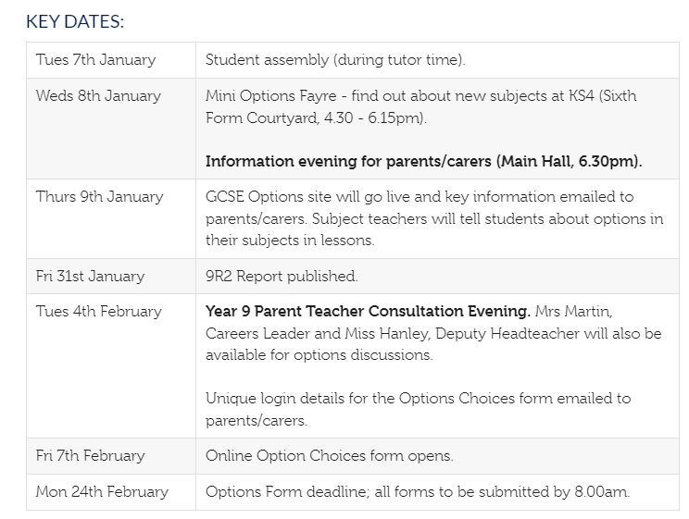
What Next?
Have a look at these dates and make a note of them in your diary
Plus: visit to Hartpury University on either 29th or 31st January – range of activities aimed at raising aspirations and considering options both post-Year 9, and looking ahead to Post-16 and Post 18
SDG PROGRESS REPORT 2025
Inspiring lives through learning

Slide 21
Who to ask for advice?
Miss Hanley, kjh@bournside.gloucs.sch.uk
Mrs Martin – Careers Leader gcm@ (she is the best person to contact about apprenticeship and employment routes)
Mrs Littlewood – Deputy Head of Sixth Form (Academic) ll@ or Miss Brown – Assistant Head of Sixth Form (Academic) mab@ (they will be able to advise about universities in particular)
careers@bournside.gloucs.sch.uk – for general enquiries; will be picked up by one of the team
Their tutor, teachers etc…..
Thanks for coming – please stay and ask questions if you have any.
SDG PROGRESS REPORT 2025
Inspiring lives through learning

Slide 22

Thank you.
Have a good day!
Inspiring lives through learning

